Slide 1
Student’s Learning Transformation via Ranking and Sense-Making Tasks in Introductory Physics Courses
Orlando M. Patricio
Laredo Community College
Laredo, TX 78040

Slide 2
Rationale
The transformational effect(s) of the independent variable of using ranking and sense-making tasks in introductory physics courses (College and University Physics II focus on electricity and magnetism)
Ranking and sense-making tasks follow a one-month student practice or immersion period (March 2017) and one-month of actual data gathering (April 2017)
Dependent variables include (1) student success as measured by pre/posttest scores and (2) final exams.

Slide 3
Rationale
The student’s portfolio of the ranking and sense-making tasks or activities were assessed using the Natural Sciences Critical Thinking Scoring Rubric to determine students’ level of understanding of physics concepts and principles and to ascertain their level of critical thinking skills.
To gain better insights of the productive elements of the ranking and sense-making tasks or activities, students’ impressions were collected and analyzed.

Slide 4
Conceptual Framework
The physics classes (College and University Physics) were not altered nor modified for this study. The ranking and sense-making tasks were embedded in the usual classroom activities (Spring 2017).
Usual classroom activities include lecture-discussion via use of board and power points, problem sessions, demonstrations, traditional and computer-based labs (Spring 2016).
Ranking and sense-making activities were either given as an assignment (individual or partnership) or project.

Slide 5
Conceptual Framework
To establish the effectiveness of the strategies, the existing student tests scores (final exams and pre/posttests) in Spring 2016 (without the activities) were compared with the student tests scores this Spring 2017 (blended with the activities).
The pretest scores of both groups (Spring 2016 and Spring 2017) were compared to determine the entry level of the students.
The pretest and posttest scores for both groups were also compared to ascertain that the two strategies (without and with activities) may be as effective as the other.

Slide 6
Conceptual Framework
The final exams and posttests scores for both groups were compared to determine which strategy has better transformational effect(s) in learning physics.
The student’s impressions (Spring 2017) provides more insights on the transformational effect(s) of the ranking and sense-making tasks.

Slide 7
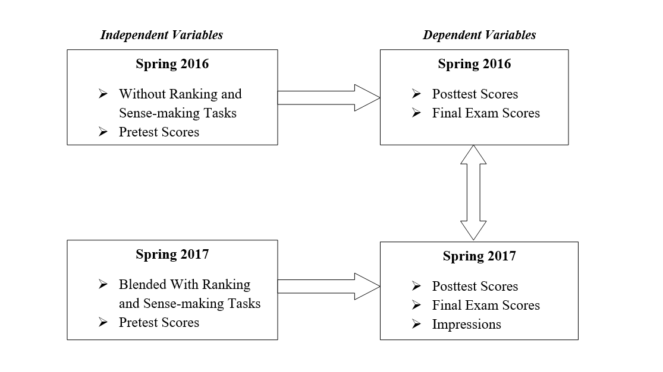
Conceptual Framework
The following diagram summarizes the framework for this research study.

Slide 8
Characteristics of Subjects
In both Spring 2016 and Spring 2017, all subjects (100%) were either Hispanics or Mexican-Americans.
Out of the 50 subjects, 98% fall under the age range of 18-26. Only 2% were above 26.
Female – 18 out of 50 (36%)
Male – 32 out of 50 (64%)

Slide 9
Table 1. Comparison of Spring 2017 and Spring 2016 Pretest Scores (Included are only those with pretest and posttest scores)

Slide 10
Pretest Scores Between Spring 2017 and Spring 2016
The statistical test has failed to reject the null hypothesis: Mean % Pretest Scores between Spring 2017 and Spring 2016 are equal.
Table 1 reveals that there is no statistical difference (p-value = 0.43 for one-tail and p-value = 0.86 for two-tail) between the means of the two groups in Spring 2017 and Spring 2016.
This implies the two groups have comparable background knowledge before taking introductory Physics courses, particularly electromagnetism.

Slide 11
Table 2. % Gain (Spring 2017 vs. Spring 2016)
Sem & Year | Mean % Pretest Scores | Mean % Posttest Scores | Gain
Spring 2017 | 40.52 | 58.37 | 0.3001*
Spring 2016 | 40.04 | 57.65 | 0.2937*
Gain = (Mean % Pretest – Mean % Posttest) / (100 – Mean % Pretest)
* There is a significant gain between pretest and posttest

Slide 12
Table 3. Posttest vs. Pretest Scores in Spring 2016 (Without the Activities)

Slide 13
Posttest vs. Pretest Scores in Spring 2016
The statistical t-value is greater than the critical t-value. The null hypothesis: the mean pretest and posttest scores are equivalent is rejected .
Results show that the mean posttest and pretest scores in Spring 2016 are statistically different with a p-value less than 0.01.
The usual classroom activities (without ranking and sense-making tasks) are effective in improving student’s learning in introductory physics.

Slide 14
Table 4. Posttest vs. Pretest Scores in Spring 2017 (Blended with Activities)

Slide 15
Posttest vs. Pretest Scores in Spring 2017
Table 4 shows that the statistical t-value is also greater than the critical t-value. The null hypothesis is rejected that the mean pretest and posttest scores in Spring 2017 are equivalent.
Results indicate that the mean posttest and pretest scores in Spring 2017 are statistically different with a p- value less than 0.01.
The usual classroom activities blended with ranking and sense-making tasks are effective in students’ transforming learning in introductory physics.

Slide 16
Table 5. Posttest Scores Between Spring 2017 and Spring 2016 (Included are those with pretest and posttests only)

Slide 17
Table 6. Final Exam Scores Between Spring 2017 and Spring 2016 (Included are those with pretest and posttests only)

Slide 18
Posttest and Final Test Scores Between Spring 2017 and Spring 2016 (Included are only those with pretest and posttests scores)
Table 5 presents no statistical significant difference of the Posttest Scores between Spring 2017 and Spring 2016. Table 6 reveals the same results as Table 5. The two groups are statistically equivalent in terms of the Final Exam Scores.
Although it seems that the usual classroom activities blended with ranking and sense-making tasks are as effective compared to the other strategy, it displays better results as revealed by the variance.
Variance was a great deal less in the 2017 Posttest and Final Exam Scores.
This implies that the spread of Posttest and Final Exam Scores (separately) in Spring 2017 are closer to the mean. Generally speaking, the students came out stronger as a group in answering questions and problems in introductory physics, particularly electromagnetism.

Slide 19
Sample of Students Work on Ranking and Sense-making Tasks

Slide 20
Sample of Students Work on Ranking and Sense-making Tasks

Slide 21
Student Impressions on the Use of Ranking and Sense-making Tasks
“I think the project was a great idea and helped many to have a better overall understanding of magnetic field, resistors, capacitors, and coils, than just in class.” – Student 1.
Having been taught more about concave and convex mirrors, lenses, parallel circuit, series circuit, Faraday’s law, Maxwell’s equations, ammeters, Ohm’s law, and more theories, our instructor made sure that we could grab as much help as possible for our own benefit. Every single worksheet that we were handed out to do, we needed to comprehend and make critical thinking part of an everyday habit. Practicing all the problems made our perception of each subject easier to comprehend…, we could understand every problem in detail and gather all the possible information to complete and master the problem. All the worksheets given were an extra boost to our knowledge…” Student 12.

Slide 22
Student Impressions on the Use of Ranking and Sense-making Tasks
“The PER assignments were pretty helpful to enforce the understanding we had for the problem given by practicing. The practice of the PER assignments helped on figuring out what was the reason behind some errors on previous questions, and they clarified some misunderstandings that was in the class.” - Student 8.
“Personally, I saw the PER assignments as something that was unnecessary, for we already had assignments for the lecture, but after a few PER assignments I noticed that I managed to have a better understanding of the material.” - Student 4.
“The PER assignments made me realize the errors I committed and was making throughout the process. Now, I actually learned and understood everything we went over throughout the lecture session. It made so much sense.” – Student 17.

Slide 23
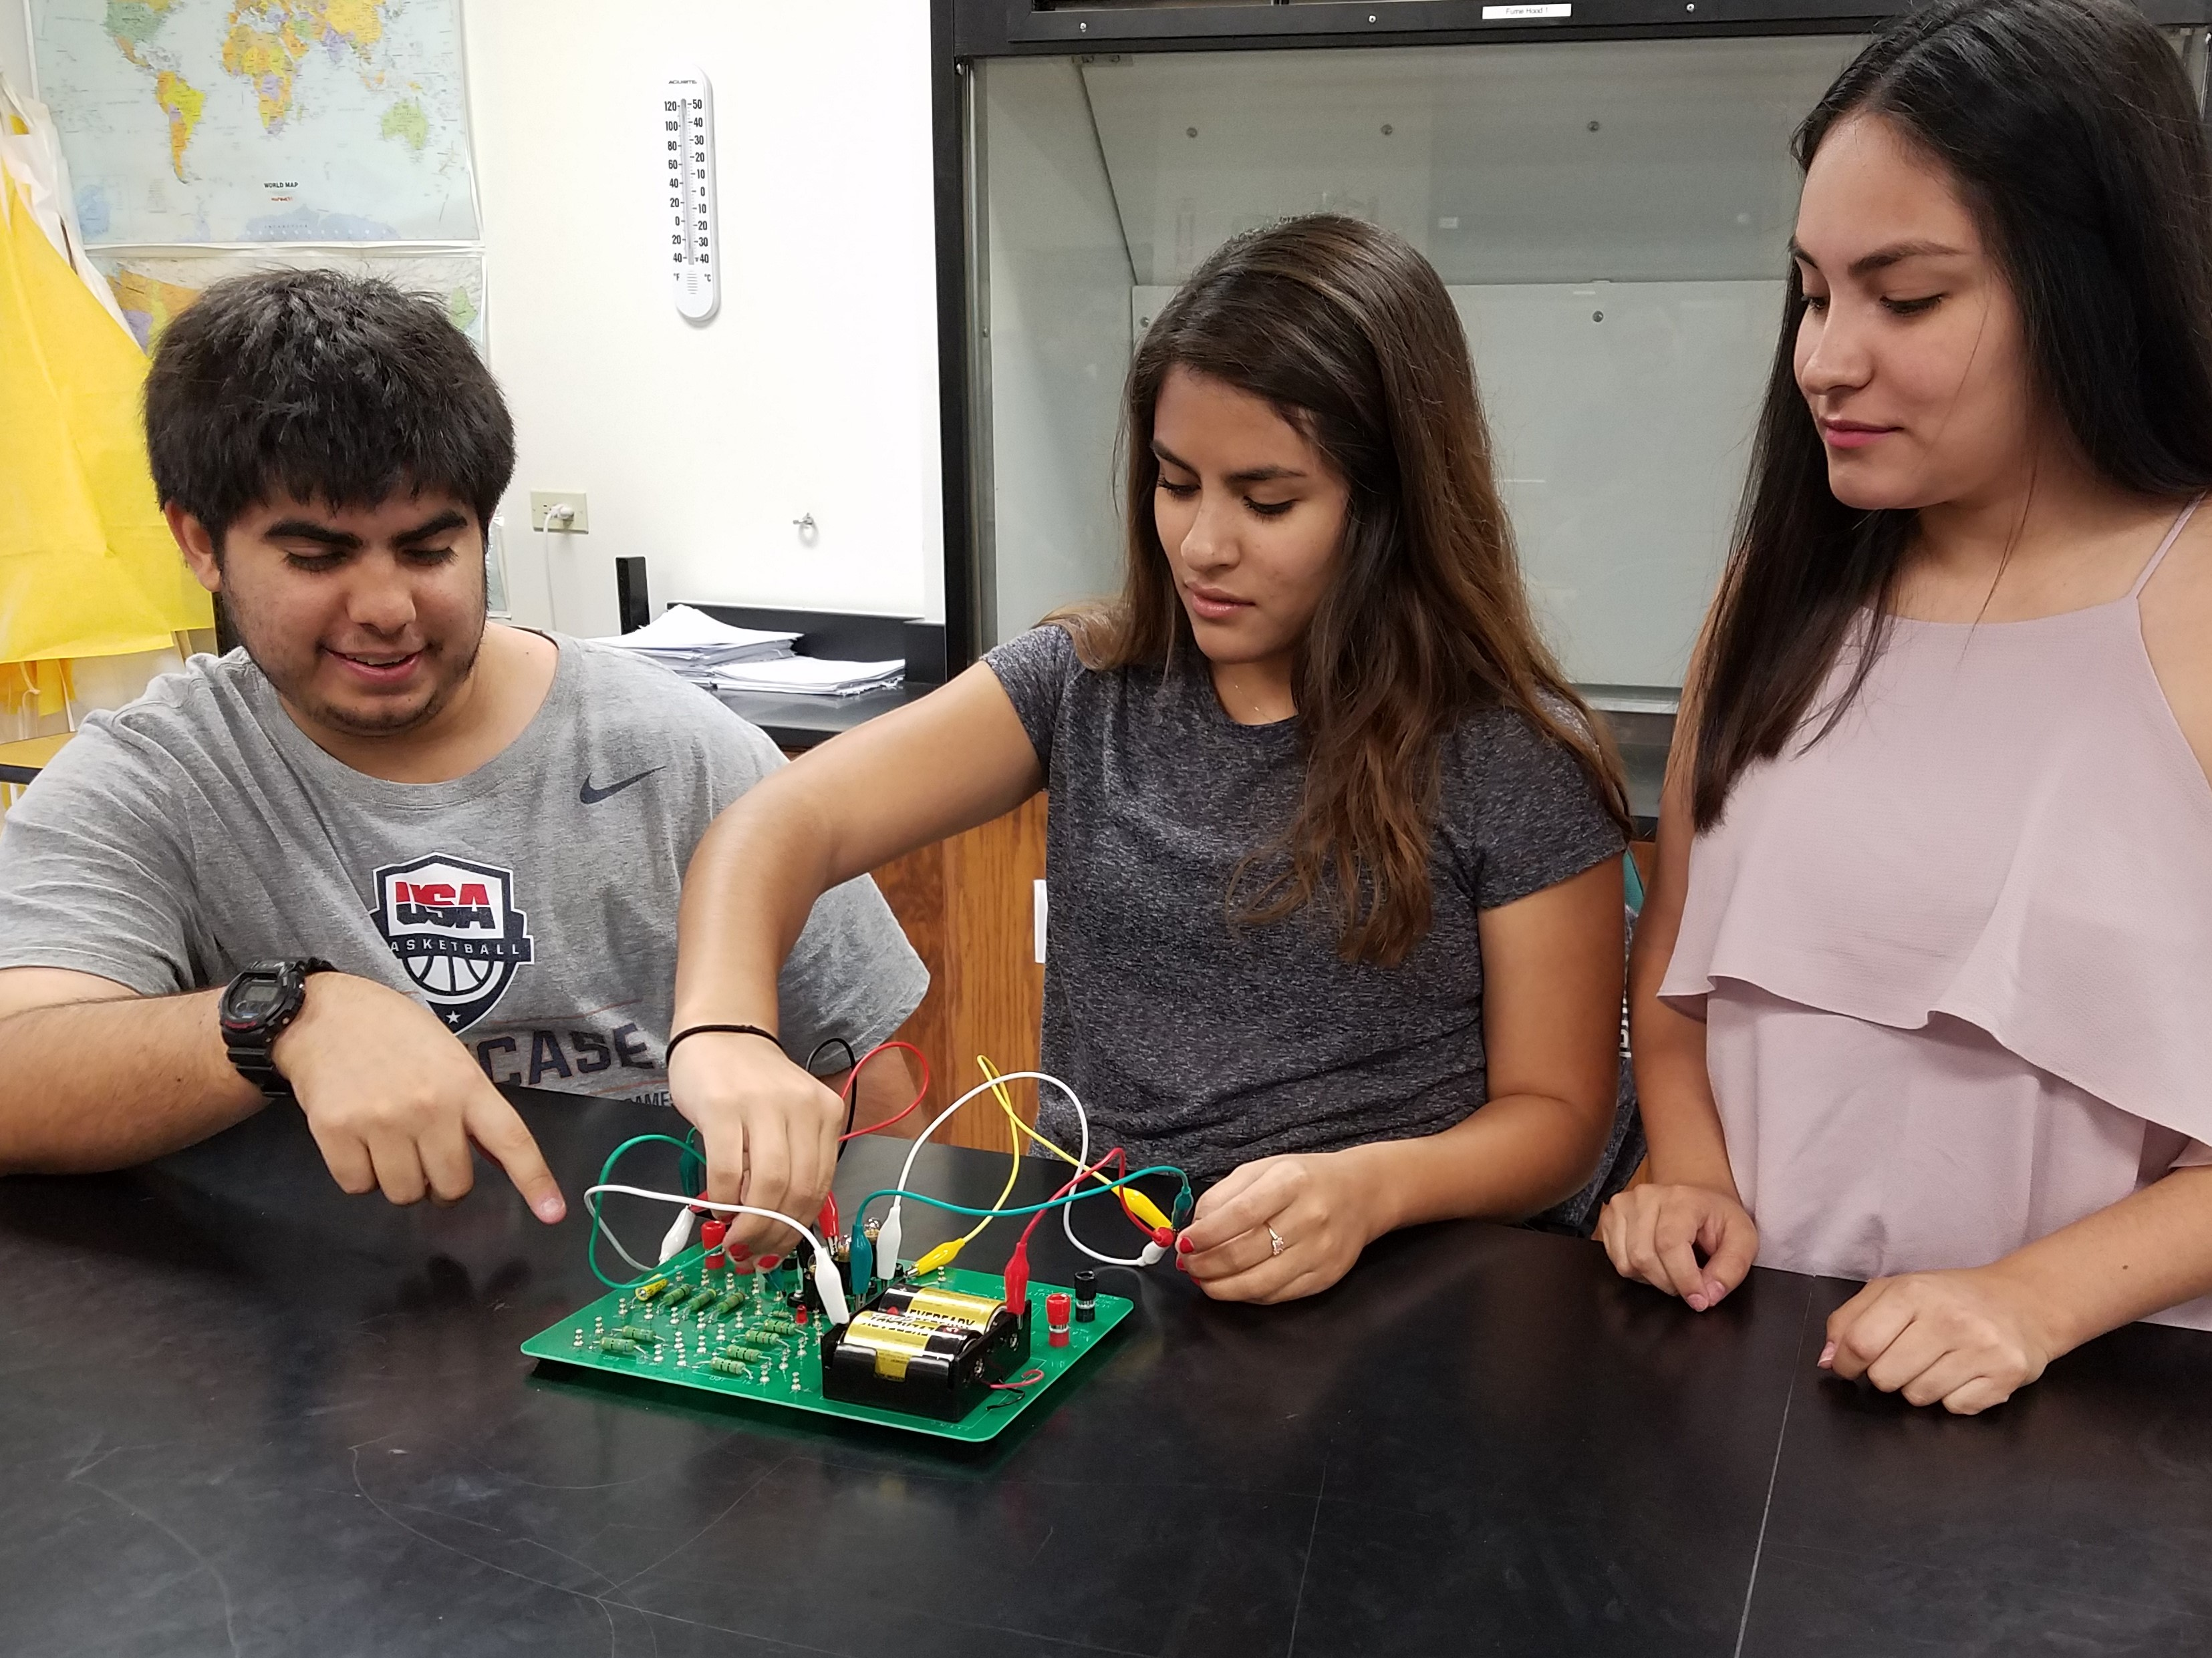
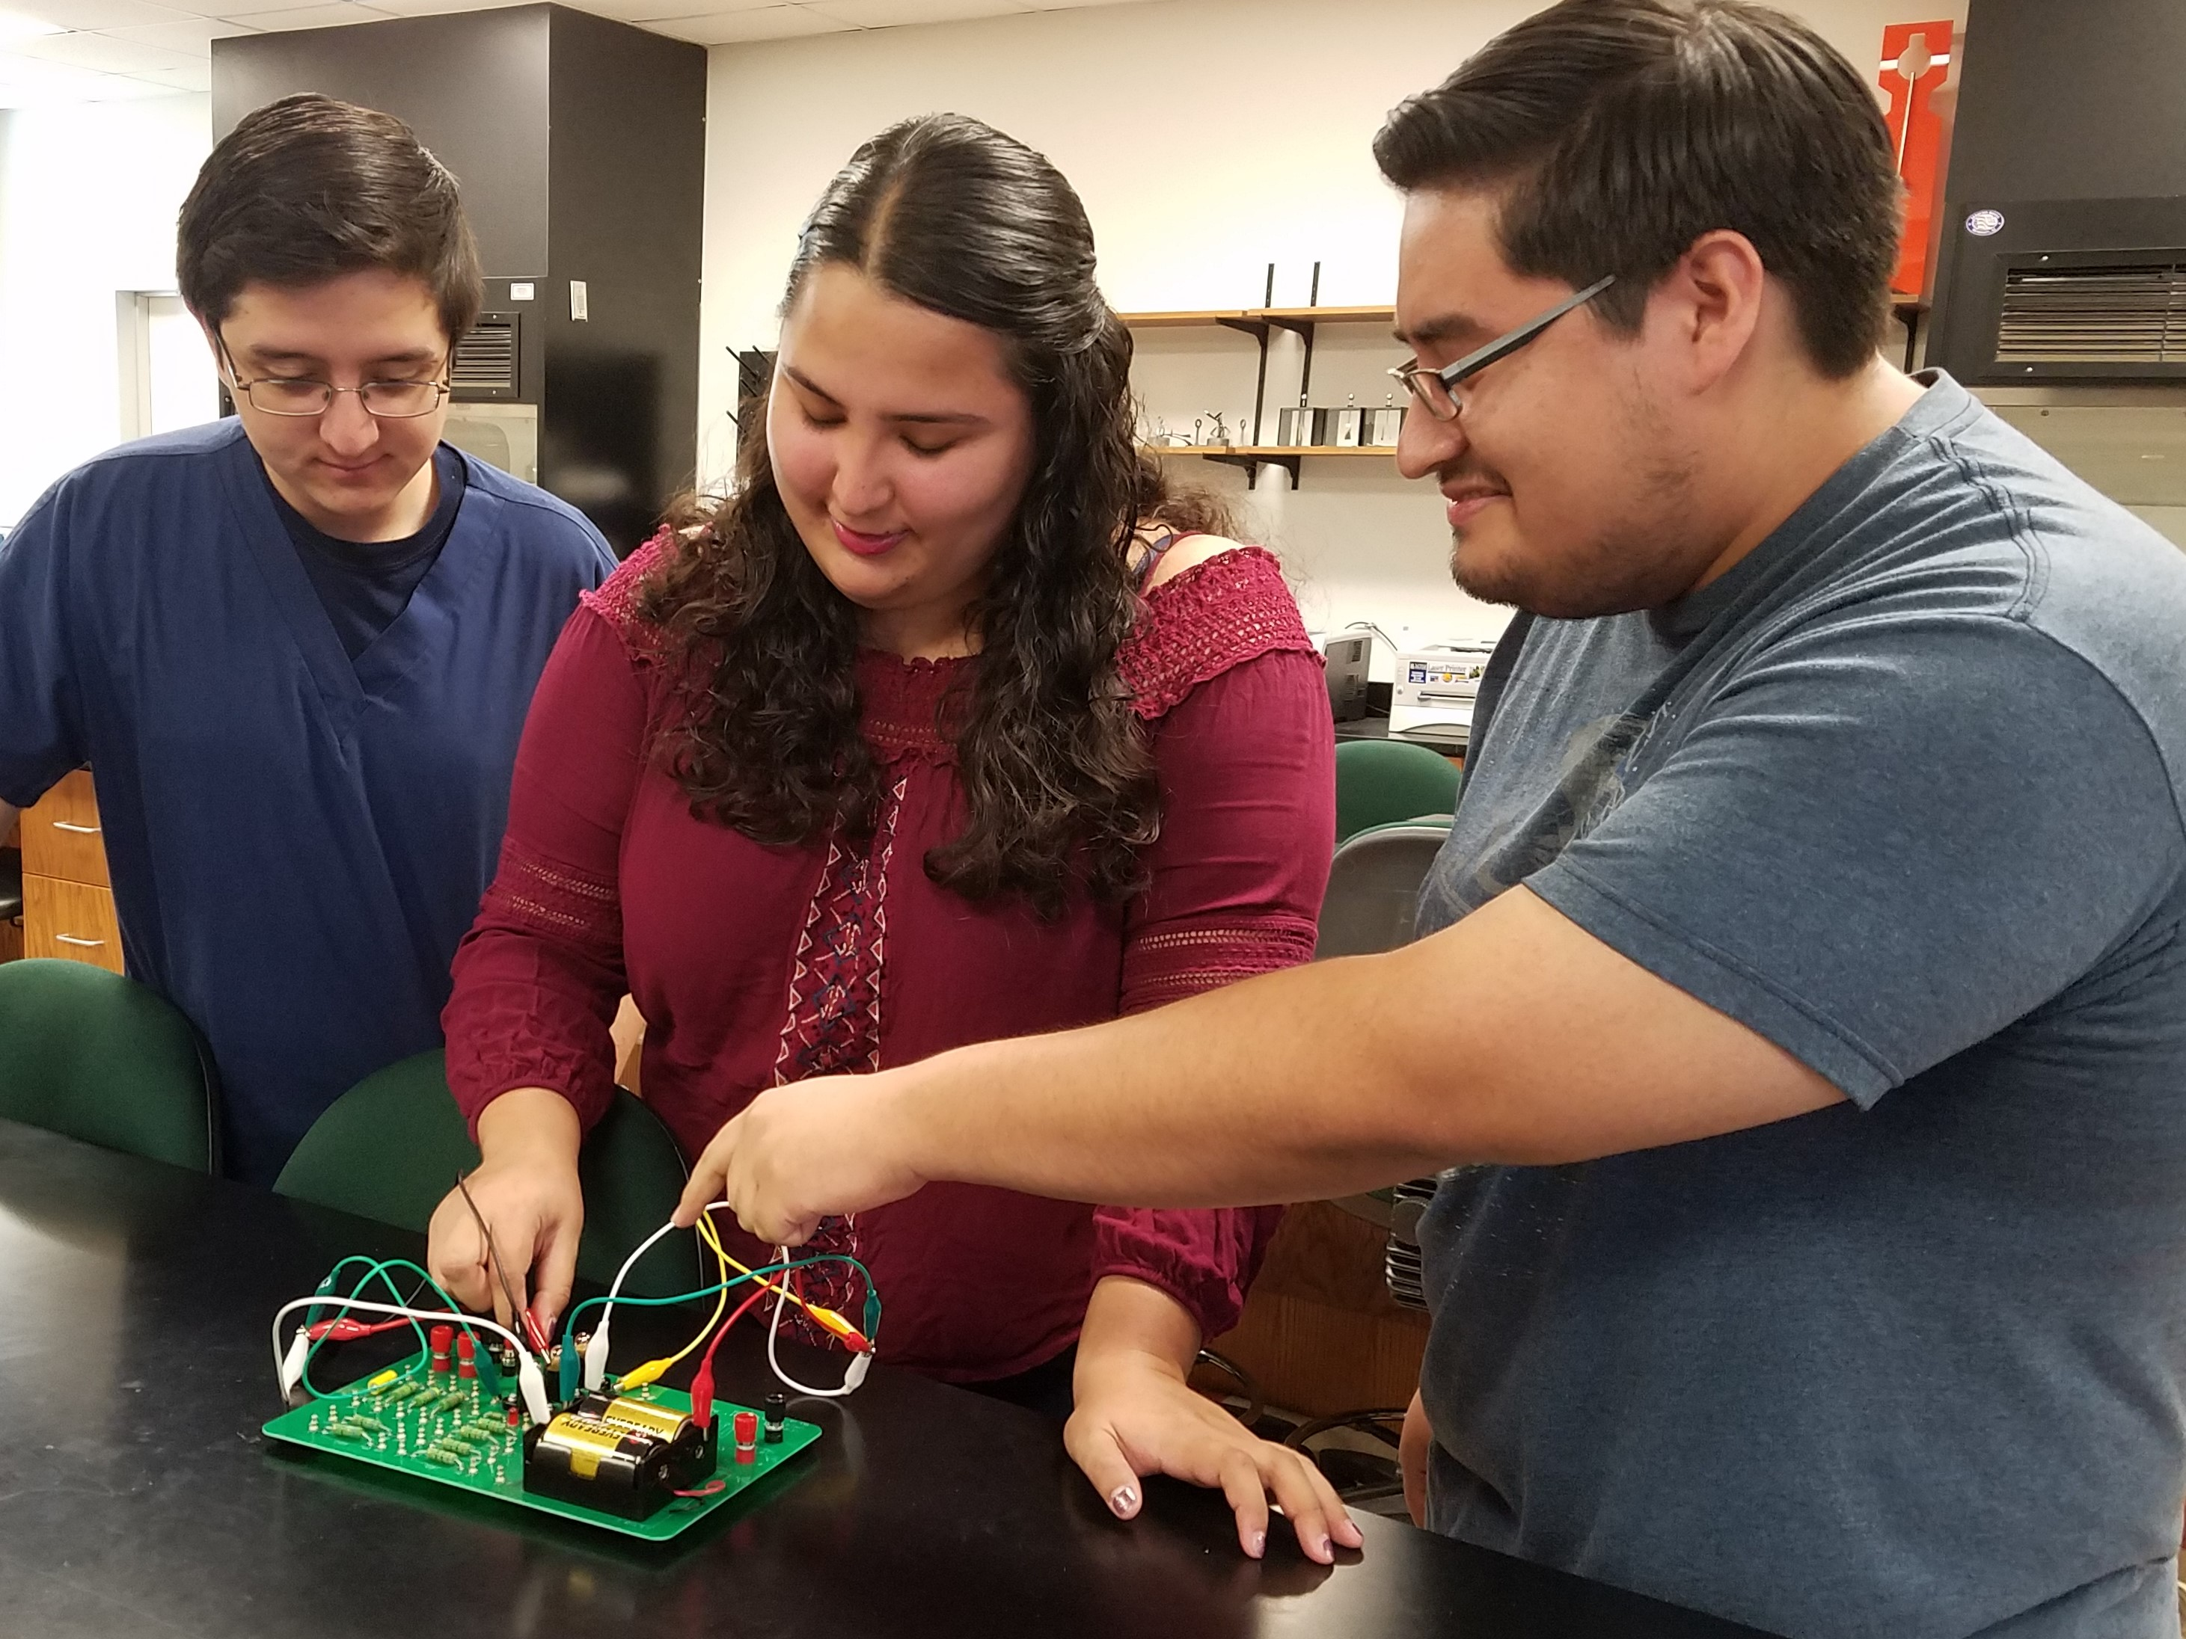
Critical thinking skills
Students were able to interpret graphics and statements more accurately.
The students can support or justify better arguments especially when they confirm results with simple experimental verification. Please see sample pictures provided below:

Slide 24
Critical thinking skills
They now have better ways to connect concepts with numerical answers and formulas.
Students realize the relevance in making sense of the problem’s answers.
Alternative points of view of their partners or the one provided in the PER assignments are essential in their understanding.

Slide 25
Conclusion
Performance of students using the Ranking and Sense-making Tasks was comparable with their counterparts without the activities. The average score of the group that was exposed to the activities were a little higher than the other group, but not statistically different.
Moreover, the variance of the Final Exam and Posttest results were closer to the mean. This suggests that the Ranking and Sense-making activities reach out to all types of learners. There is a better learning transformation for all, varied types learners.

Slide 26
Conclusion
The exposure to the activities is one month practice and another month of actual data collection. A longer time to conduct the activity(ies) suggests a possibility of better scores.
The students’ critical thinking skills were enhanced and now they realized the importance of making sense in their answers instead of just giving the correct answers.

Slide 27
References
Borrego, M. & Henderson, C. (2014). Increasing the Use of Evidence-Based Teaching in STEM Higher Education: A Comparison of Eight Change Strategies. Journal of Engineering Education, 103(2), 220-252.
Megowan-Romanowicz, C. (2016). Whiteboarding: A Tool for Moving Classroom Discourse from Answer-Making to Sense-Making. The Physics Teacher, 54, 83-86.
Michael, J. (2006). Where’s the Evidence that Active Learning Works? Adv Physiol Educ, 30, 159–167, retrieved from http://advan.physiology.org/ by 10.220.33.4 on September 27, 2016.
Prensky, M. (2001). Digital natives, digital immigrants. On the Horizon, 9(5), 1-6.
Smith, A. C., Stewart, R., Shields, P., Hayes-Klosteridis, J., Robinson, P. & Yuan, R. (2005). Introductory Biology Courses: A Framework to Support Active Learning in Large Enrollment Introductory Science Courses. Cell Biology Education,4, 143-156.
Smith, K., Sheppard, S.D., Johnson, D. W., & Johnson, R.T. (2005). Pedagogies of Engagement: Classroom-Based Practices. Journal of Engineering Education, 1-15.

Slide 28
Credits
Pearson has approved the use of some ranking and sense-making tasks or activities in electricity and magnetism.
Thanks to Pearson and the authors of ranking and sense-making tasks.
Special thank you to the NFE-TYC (organizers) for the innovative strategies, training, and opportunity.
Special acknowledgment and gratitude to Laredo Community College and the IRB committee for allowing me to conduct this physics education research.

